Slide 1
Why should we learn Python?

Slide 2

Python
Python is a high level Programming language, by the use of python we create complex computer programs.
Python is also known as Interpreted language.

Slide 3
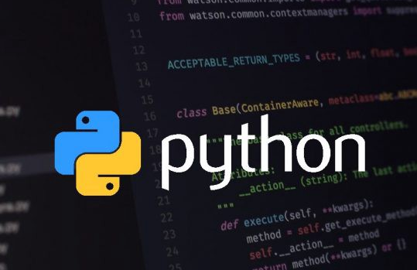
Python used in various fields
Python can be used in different ways such as:
Software developers
Data scientists
Data Analysts
Hackers
Bankers
Engineers
Designers
Doctors
Scientists,etc.

Slide 4
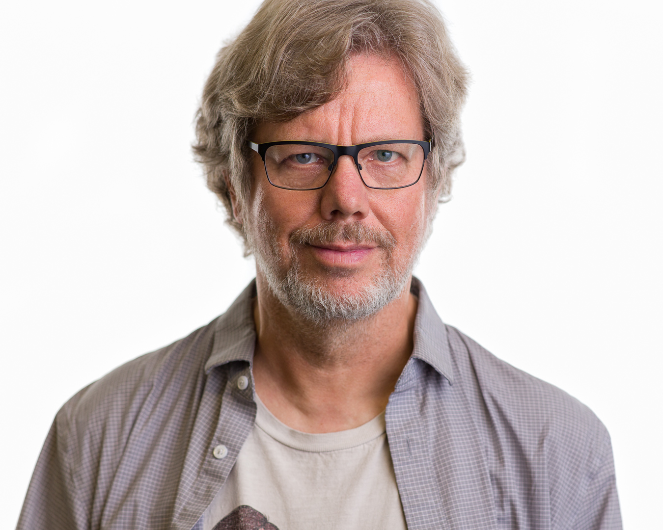
Why Python is known as Python?
Python is named after a comic series.
Guido Van Rossum is the creator of Python.
Python is an easy programming language, using python the complex programs can be written.
Guido van Rossum
The author of the Python programming language

Slide 5
Advantages of Python
Python can be used online, offline.
And Python can be used in Smaller or big projects.
Python is an Interpreter language, where Programs can be executed directly without a compiler.

Slide 6
Applications of Python
Web application.
Mathematical Computations.
Graphical User Interface.
And many more…

